Slide 1

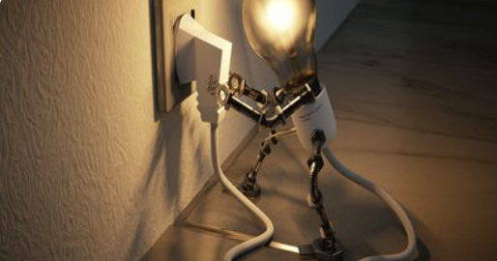

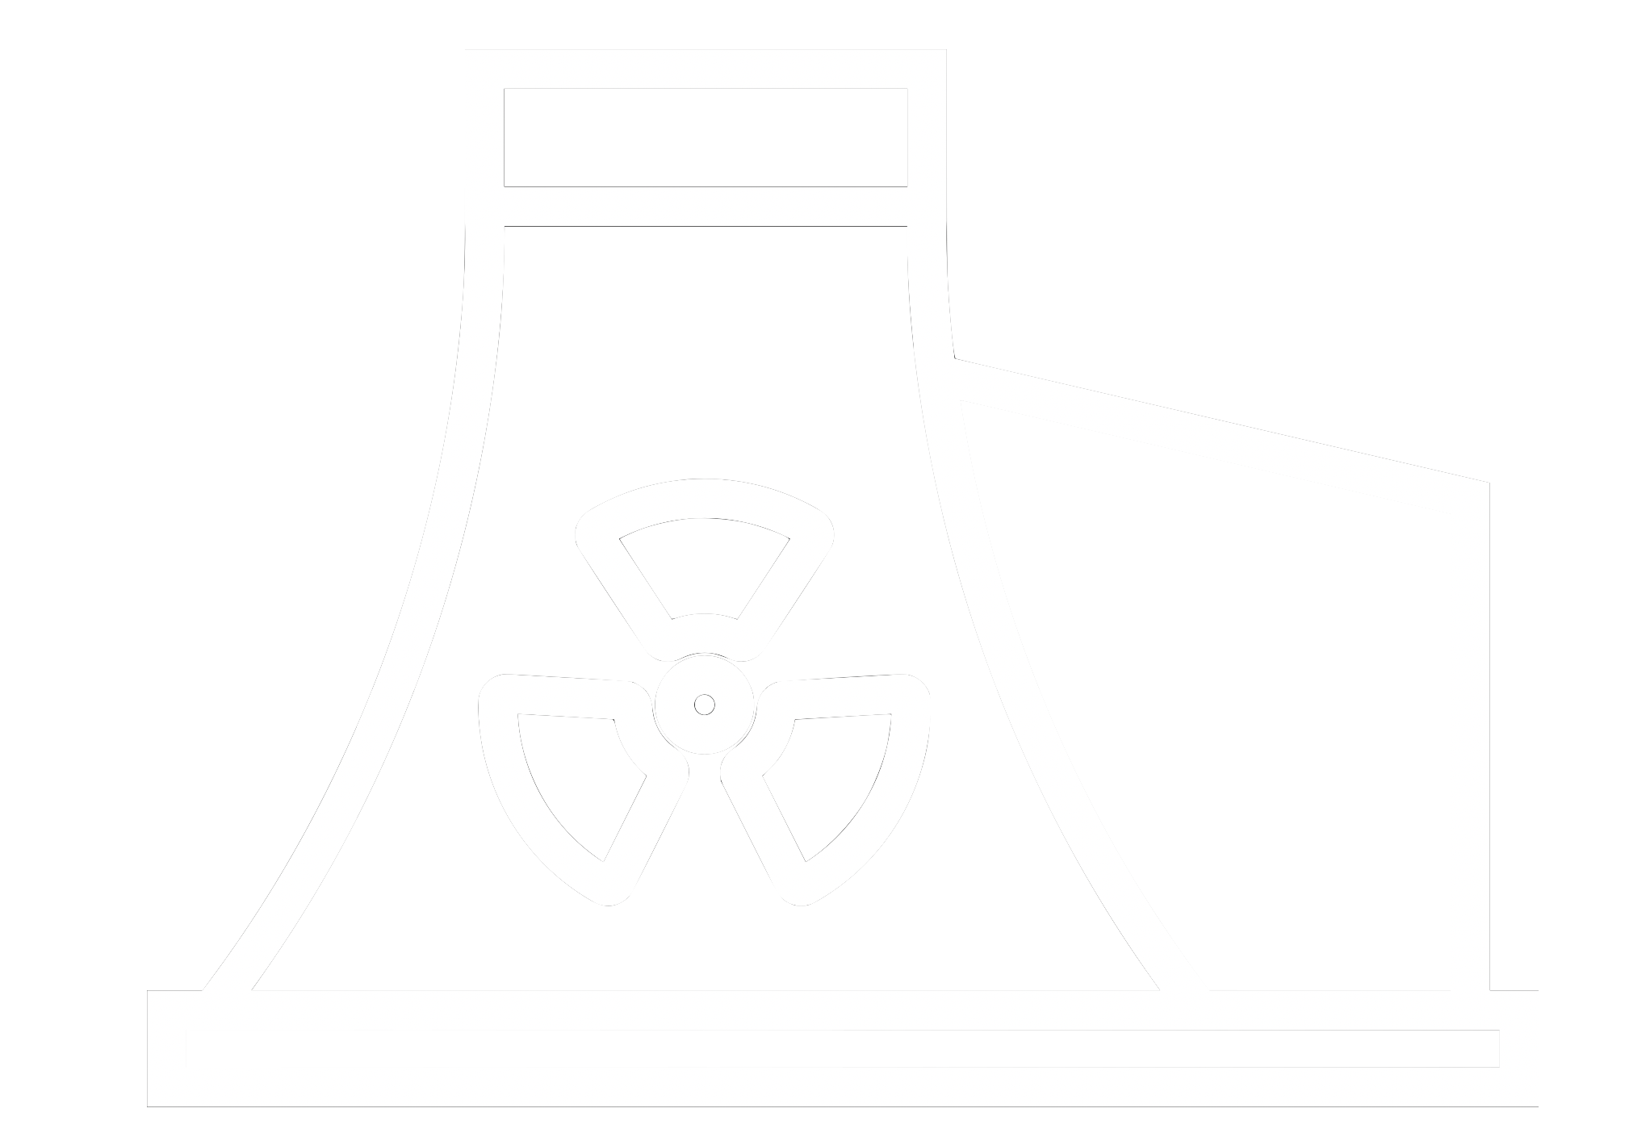
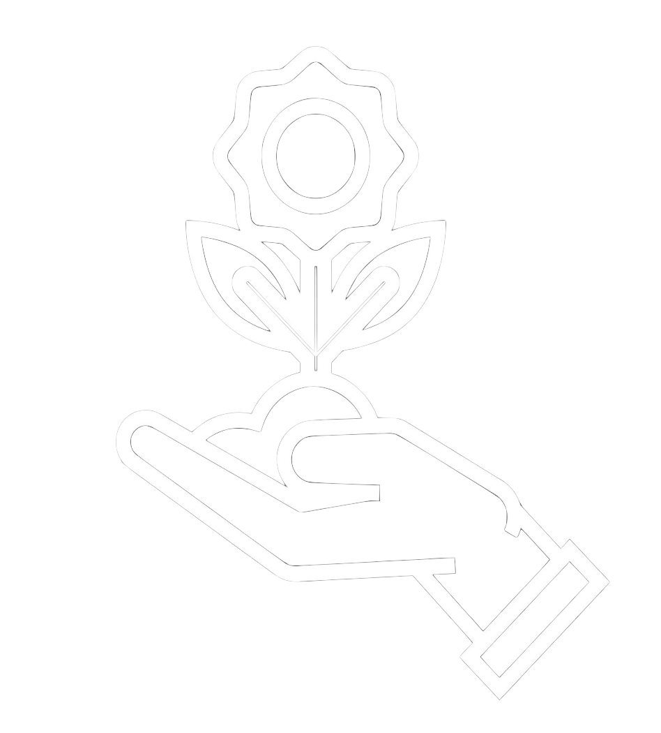







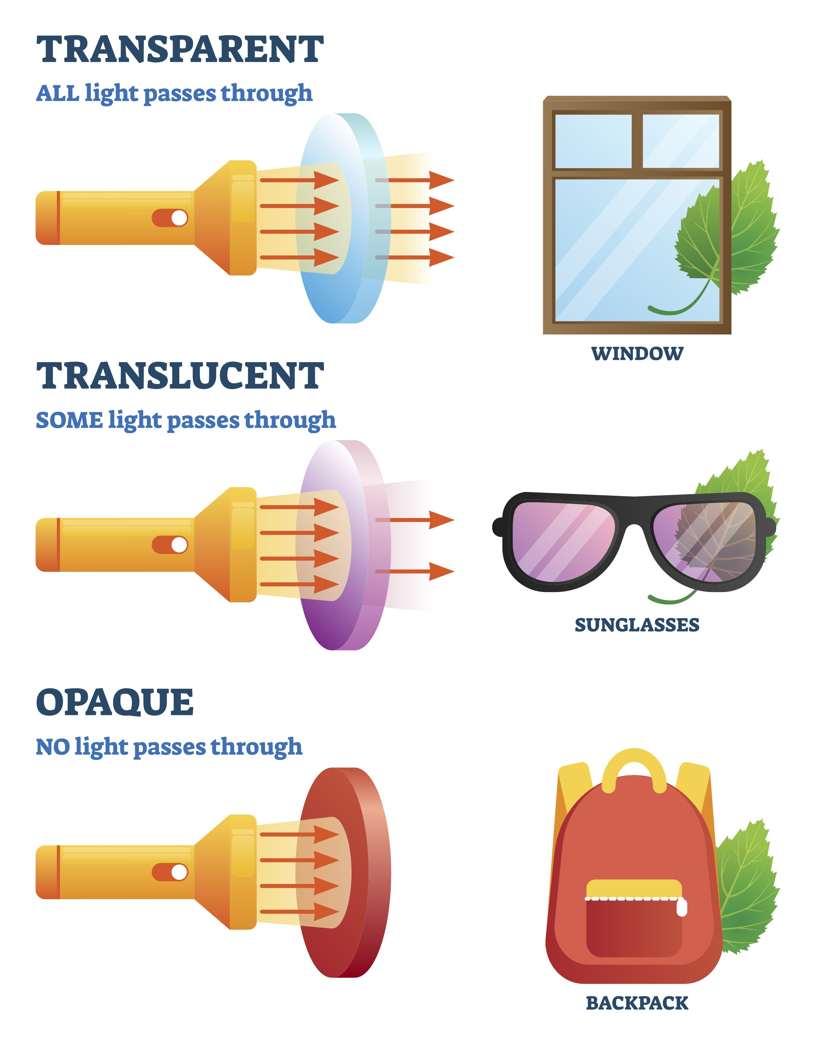
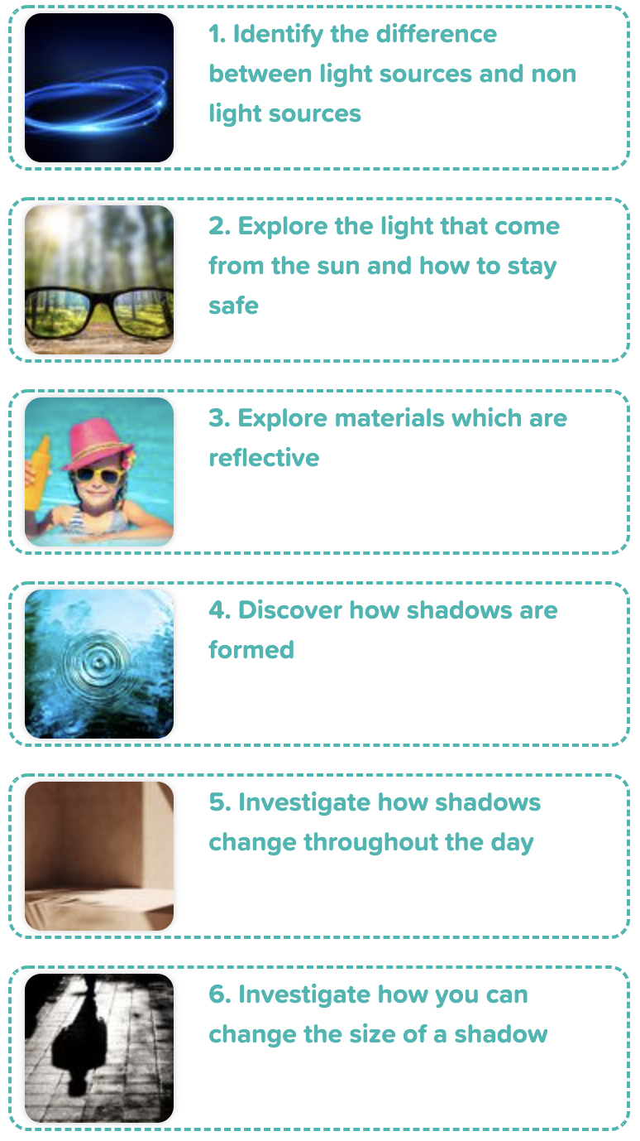
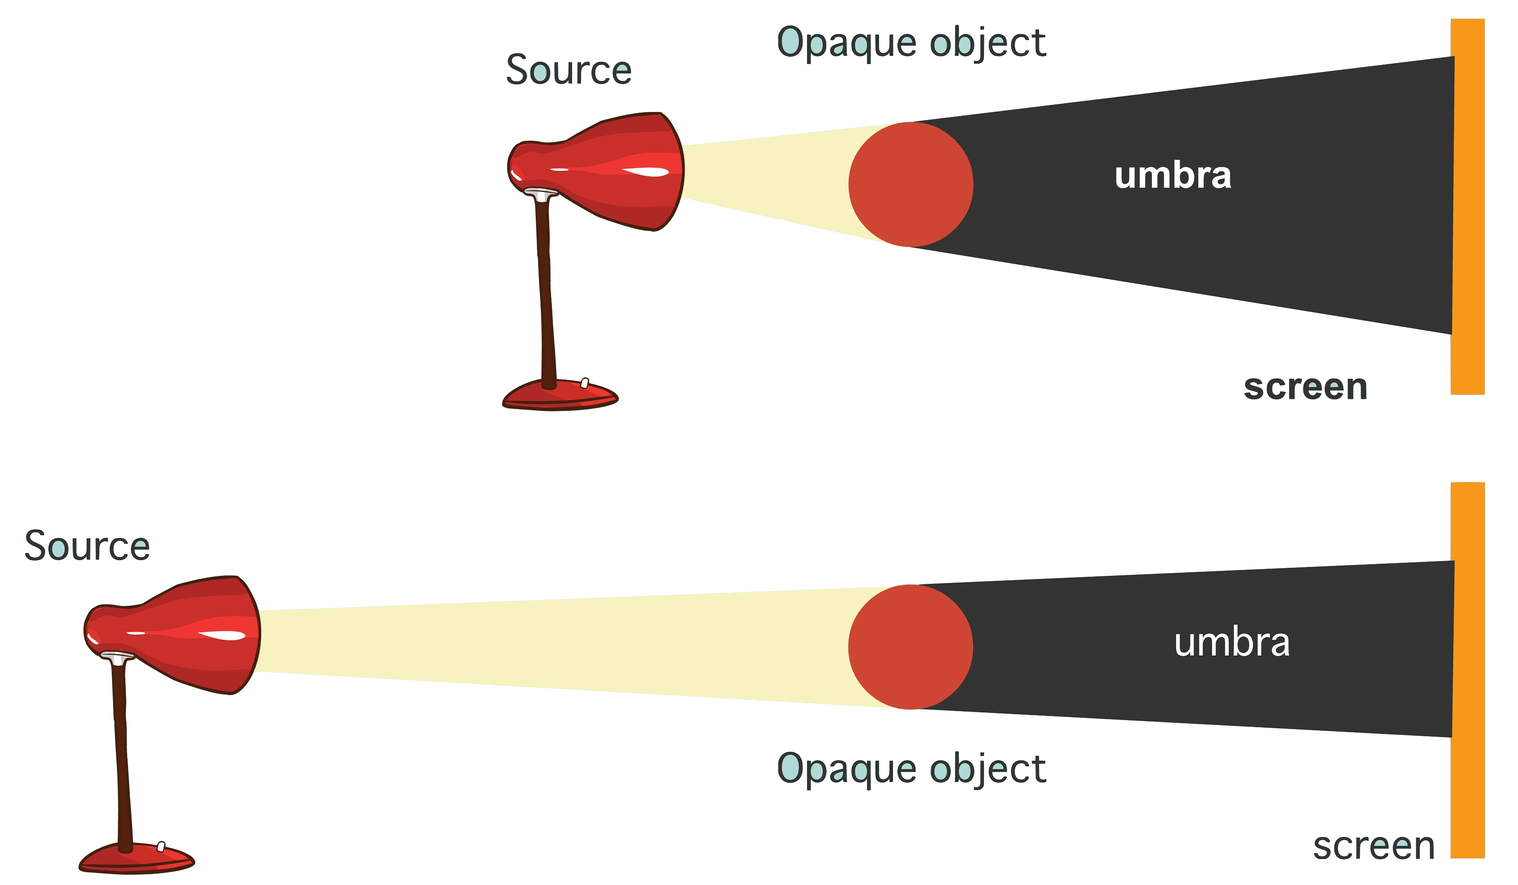

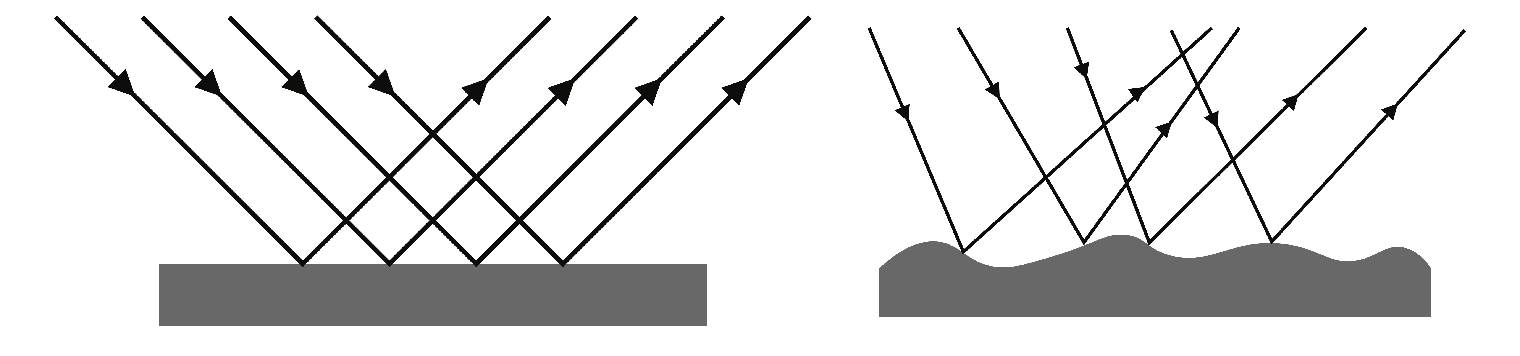
Careers connected to light:
optometrist, optic scientists, lighting engineer
Knowledge Organiser: Light
Careers connected to the human body:
doctor, nurse, massage therapist, personal trainer, theatre technician
Mirrors and reflection
Size of a shadow changes
Lesson Sequence
A shadow is caused when light is blocked by an opaque object. A shadow is larger when an object is closer to the light source. This is because it blocks more of the light.
Mirrors reflect light very well, so they create a clear image. An image in a mirror appears to be reversed. For example, if you look in a mirror and raise your right hand, the mirror image appears to raise its left hand.
1. Identify the difference between light sources and non-light sources
opaque object
source
2. Explore the light that comes from the sun and how to stay safe
screen
3. Explore materials which are reflective
source
opaque object
Light is reflected from surfaces
screen
4. Discover how shadows are formed
Key Facts
Light from the torch hits the object.
The light is reflected from the object.
We need light to be able to see things. Light travels in a straight line. When light hits an object, it is reflected (bounces off). If the reflected light hits our eyes, we can see the object. Some surfaces and materials reflect light well. Other materials do not reflect light well. Reflective surfaces and materials can be very useful. Remember the Sun can be dangerous.
5. Investigate how shadows change throughout the day
regular reflection
irregular reflection
6. Investigate how you can change the size of a shadow
Developing Experts Copyright 2022 All Rights Reserved

Slide 2
Knowledge Organiser: Light
Careers connected to the human body:
doctor, nurse, massage therapist, personal trainer, theatre technician
Before and After Test
before
after
before
If you were to pay a visit to a funfair, which diagram shows a reflective surface which is likely to distort your reflection?
How does light travel?
after
Sources of light include…
In a straight line
In a curvy line
Light is everywhere
Light does not travel
the sun
the moon
street lights
torches
before
after
Looking directly at the Sun is…?
before
after
Dark means?
When there is a little bit of light so you can see
before
after
before
after
dangerous
The absence of light
safe
You must eat carrots so you can see
ok if there are clouds
The switch is turned off
ok if the sun is rising or setting
When light bounces off a surface, it is..?
before
after
What is the correct meaning of translucent?
before
after
absorbed
semi-transparent
dissolved
opaque
before
after
before
after
reflected
transparent
bounced
solid
Developing Experts Copyright 2022 All Rights Reserved

Slide 3
Unit Rocket Words: Year 3 – Light
Rocket Words
light | a form of energy that allows our eyes to see
reflect | the process that describes light bouncing off a surface
vitamin D | a vitamin that come from sunlight or food and important for bone strength
ultraviolet rays | type of light that can be harmful
fluorescent | gives a highly visible reflection of light
high visibility | can be seen easily
shadow | a dark image that is formed when an object blocks the light
ray | a thin beam of light
cast | to throw or project
position | where something is placed
shape | the outline of something
puppet | a doll that looks like a person or an animal
Developing Experts Copyright 2022 All Rights Reserved

